Slide 1
Accelerate Delaware’s “The Coffee Shop”
Team 6
Deshaun Crawford
Michael Green
Curtis Hite
Robert Morris

Slide 2
Goal
Develop a web application that will motivate people to live, work, play, and stay in Delaware
Connect people to people
Connect people to businesses

Slide 3
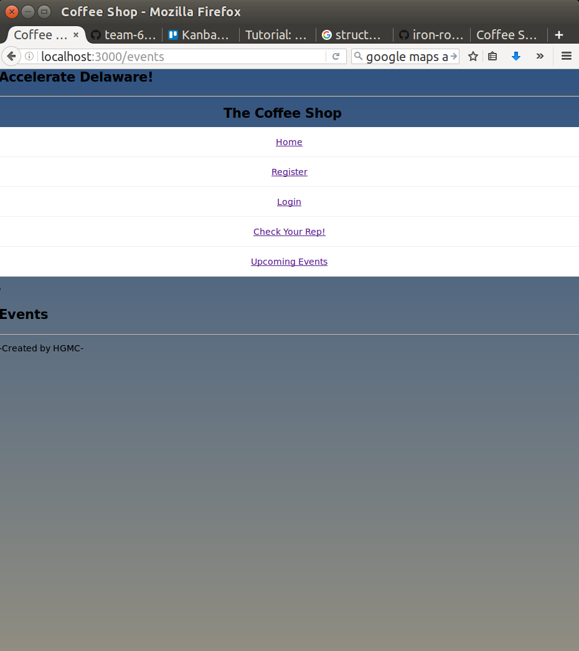
Design
Engagement
Keep people using the app
Connectivity
Socially connectivity
Familiarize people with established businesses
Data Collection
Information on users
Ease of Access
Simplicity is key
User friendly interface

Slide 4
Technologies
Meteor
Blaze.JS
Mongo DB
HTML & CSS
Node.JS

Slide 5
Features
Login with Facebook/Google/Twitter
Events brought to users Google Maps
Event check in via GPS
Easily share events to friends
Reputation
Reward system
Earn avatars, discounts, gifts

Slide 6
Roles
Michael Green – Primary Meteor programmer
Robert Morris – Multiple page routing in Meteor
Deshaun Crawford – Meteor to Amazon Web Services deployment
Curtis Hite – Google Maps integration, database schema design

Slide 7
Conclusion
We successfully developed a prototype showcasing the core features of “The Coffee Shop”
A learning experience in both web development and collaboration

